Slide 1
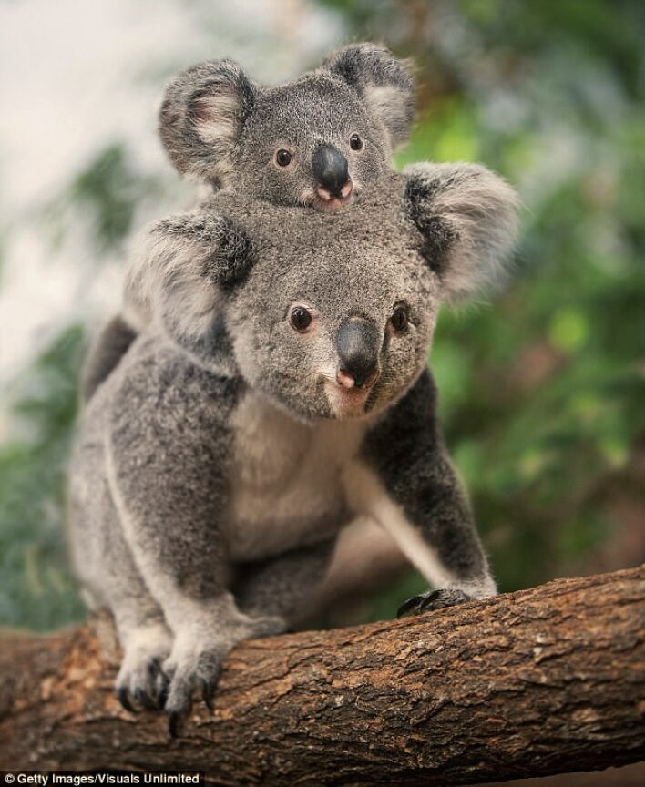
‘Saving the koalas
start with slowing down’
Social Change Solution Campaign

Slide 2
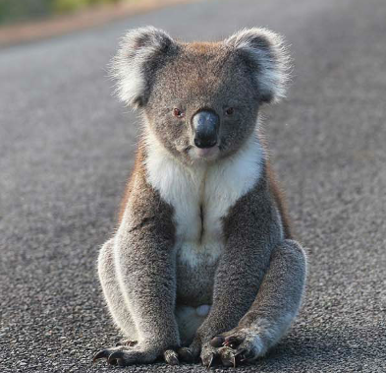
Contents
01 Social Marketing Problem
02 Customer Behavior Problems
03 Empathy Map & Persona
04 Behavior Change Objectives
05 Journey Map
06 Social Change Solutions
07 Intervention
08 Conclusion

Slide 3
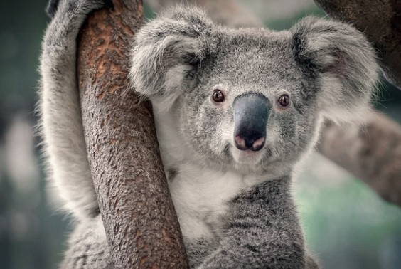
01
Social Marketing Problem
Less than 100,000 koalas left in Australia, with low estimates reaching 43,000 only (Save the koalas, 2019)
From 1997 to 2011, 10956 of the 15644 south-east Queensland koalas that died were struck by cars, mauled by dogs, or died of stress-related disease (Fairfax, 2013).
In Queensland, vehicle strike is a major threat to koalas (CSIRO, 2013). Driver’s speeding in rural areas causing koala car collisions.
On average, 300 koalas are car stroke every year, and more than 85% of those die (“Living with Wildlife”, 2019).
At this shocking rate, koalas are bound to disappear within the next 20 years (Blatchford, 2017).
Chubing Shen 44720151

Slide 4

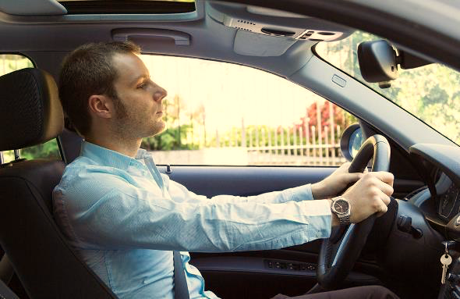
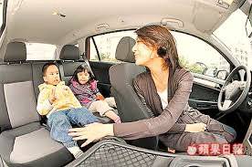
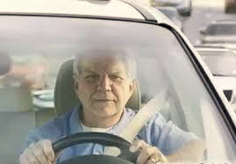
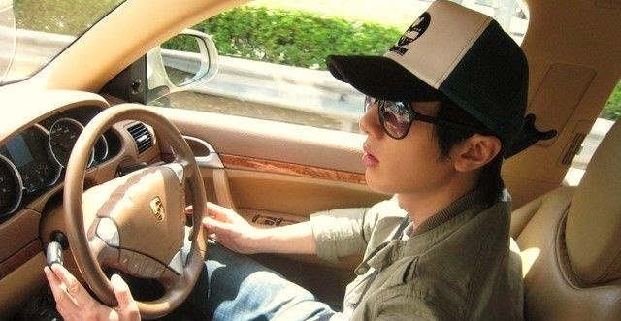
02
Customer Behavior Problems—Segments
Stressed Office Worker
(26-35 years old)(Ellison et at.,2010)
Living in (sub)urban areas
Stressed and under great pressure
(Eustace & Wei, 2010)
Daily commuting, punctuality and
enormous workloads. (Quintanilla, 2008)
Pressured Perfect Mum
(40-50 years old) (Hakamies-Blomqvist, 1994)
With kids
work-family balance(Olah & Fratczak, 2013)
Care about education, safety of kids and her positive image within the“School mums” group (Adame et al, 2016).
Adventurous Senior
(65+ years old)(Hakamies-Blomqvist, 1994)
Retirees in rural areas (CANSTAR, 2016)
Love hitting the roads to discover new places (Panagiotakos et al. 2011)
Slower reflexes, lower vision & hearing abilities (Musselwhite, 2016)
Fast & Furious
(17-25 years old) (Scott-Parker et al. 2012)
Living in rural areas (Young Driver Factbase, 2010)
Impulsive and thrill- seeking driving.
(Vassallo et al, 2013; The Social Issues Research Centre, 2004)
Care about their car, families and social status (Boteler, 2012).
Chubing Shen 44720151
CAMDEN
LOUIS PARKER
Community Impact Director

Slide 5
02
Customer Behavior Problems—Target Market
Fast & Furious
Demographic:
17-25 years old (Scott-Parker et al, 2012)
male
local/domestic resident
Geodemographic:
lives in rural areas in Australia (Young Driver Factbase, 2010)
Past Behavior:
habit of speeding and driving brutally
driving fast to use car’s speeding capacities
Chubing Shen 44720151

Slide 6
02
Customer Behavior Problems—Target Market
Fast & Furious
Attitudes:
impulsive; inexperienced (Vassallo et al, 2013)
thrill seeking; deliberately undertaking risky behaviors
(The social Issues Research Centre, 2004)
irresponsible driving; lower perception of dangers (NRHA, 2009)
peer pressured actions - impress and show off (NRHA, 2009)
Lifestyle:
heavy reliance on social media/phones (King, 2006)
engages in social activities (King, 2006)
loves play with pet
Interests & Values:
has a powerful, attractive and high-performance vehicle
(Young Driver Factbase, 2009)
high social status (Young Driver Factbase, 2009)
Chubing Shen 44720151

Slide 7
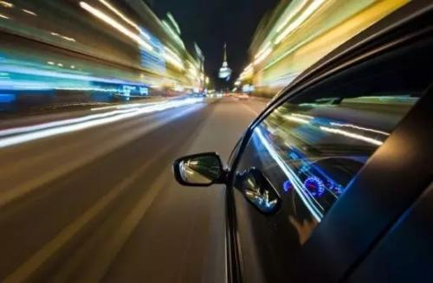
Empathy Map (Mitchell et al., 2010)
03
Said
Did
I didn’t realize I was speeding. Driving
fast relieves me a lot.
I am good at multi-tasking. What is the
point of slowing down if there is no one
on the road.
Heavy push on the pedal. Makes
accelerations noises.
Overtake others. Drives with one hand
only - one arm outside to enjoy the
pleasure
Felt
Thought
I am pretty sure that I have ability to
make immediate responses if emergency
happens.
The faster I drive, the quicker I get to my
destination.
There are no speed cameras. I won’t have
a penalty.
There are plenty of animals in the wild
anyway.
I feel cooler when driving fast. It feels
great and it pleases me to drive fast.
It feels better when using my car to its
highest capacities.
I feel proud when going fast in front of
others.
I feel the Adrenaline spiking.
I feel my body tingling and Euphoria.
Chubing Shen 44720151

Slide 8
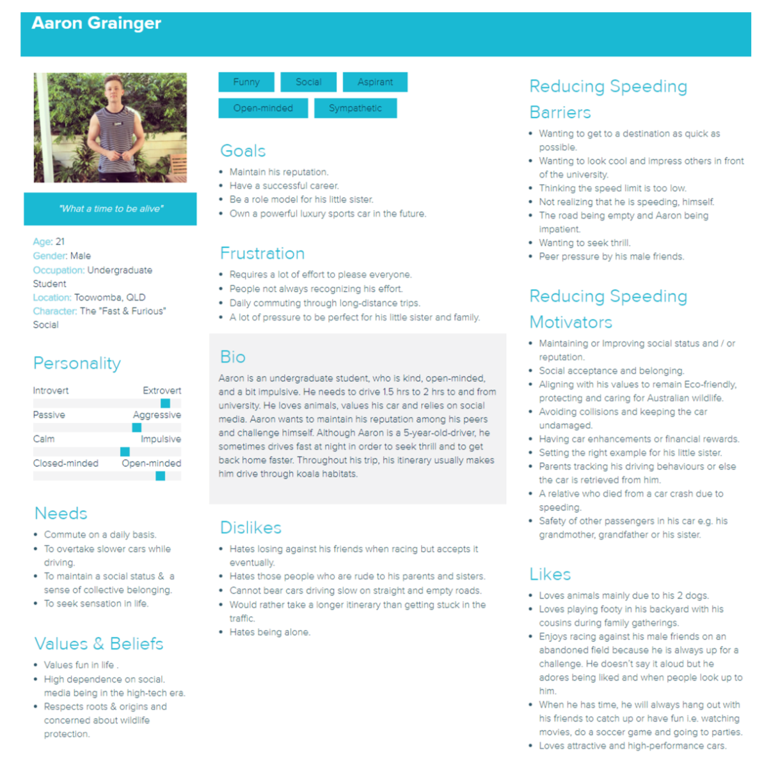
03
Persona
Chubing Shen 44720151

Slide 9

04
Behavior Change Objectives
Specific
Measurable
Attainable
Realistic
Timely
Achieving 10% of koala mortality, resulting from speeding — by promoting to slow down and raising awareness of koala’s increasing death rate in Queensland.
Measuring the amount of Queensland koala’s death through cooperation with Australian Bureau of Statistics to get real data feedback after campaign.
Each month RSPCA group organize a meeting to discuss current situation of intervention methods and adjust strategy immediately
Allocating target audience feedback about activity of slowing down to protect koalas and provide benefits they demand when changing speeding.
Achieving 10% - starts to slow down in rural areas to reduce koala’s death rate caused by car strikes by December, 2019
Aim – 10%
Start with slow down in rural areas to save the koalas
Chubing Shen 44720151

Slide 10
Reference List
Ellison, A. B., & Greaves, S. (2010). Driver characteristics and speeding behaviour, p 3. Retrieved from
https://www.atrf.info/papers/2010/2010_Ellison_Greaves.pdf
Eustace, D., & Wei, H. (2010). The role of driver age and gender in motor vehicle fatal crashes. Journal of Transportation Safety & Security, 2(1), 28-44.
Quintanilla, P. (2008). Faces at the office. Raleigh, NC: Lulu Press.
Blatchford, E. (2017). Australia is running out of koalas. Retrieved from
https://www.huffingtonpost.com.au/2017/11/06/australia-is-running-out-of- koalas_a_23267631/
CSIRO. (n.d.). Queensland Car Strike Factbase. Retrieved from
https://www.mynrma.com.au/cars-and-driving/driver-training-and-licences/risk-factors-and- young-drivers
Hakamies-Blomqvist, L. (1994). Aging and Fatal Accidents in Male and Female Drivers. Journal of Gerontology, 49(6), 286.
Adame, Caplliure, & Miquel. (2016). Work–life balance and firms: A matter of women? Journal of Business Research, 69(4), 1379-1383.
Canstar. (2016). Seniors confident behind the wheel. Retrieved from
https://www.canstar.com.au/car-insurance/seniors-confident-behind-the-wheel
Panagiotakos, Demosthenes B., Chrysohoou, Christina, Siasos, Gerasimos, Zisimos, Konstantinos, Skoumas, John, Pitsavos, Christos, & Stefanadis, Christodoulos. (2011).
Musselwhite, C. (2016). Are older people safe enough to keep driving?. Retrieved from
https://theconversation.com/are-older-people-safe-enough-to-keep-driving- 65060?fbclid=IwAR2HhBsI6lCv1tqo0nbDTikf_kATP5qRLTqNEHNK3g8hRmgxioe6ikTqY N4
Scott-Parker, B. J. (2012). A comprehensive investigation of the risky driving behaviour of young novice drivers (Doctoral dissertation, Queensland University of Technology), p 85. Retrieved from
https://eprints.qut.edu.au/59638/1/Bridie_Scott-Parker_Thesis.pdf
Mitchell, L., Bailey, T., & Thompson, J. (2010). Survey on Speeding and Enforcement- 2010 Update, Figure 2.11, p. 14. Retrieved from
https://www.racv.com.au/content/dam/racv/images/public- policy/reports/RACV%20Young%20Adult%20Licensing%20Trends%202017.pdf

